Slide 1
Competitive Cyber Security Organization
General – Wi-Fi Deauth
By attending today’s meeting you acknowledge that you may be photographed or recorded for club use

Slide 2
Announcements

Slide 3
Learning Objectives:
Wi-Fi deauthing
Wi-Fi frames
ESP-32
Programming challenges
Demo

Slide 4
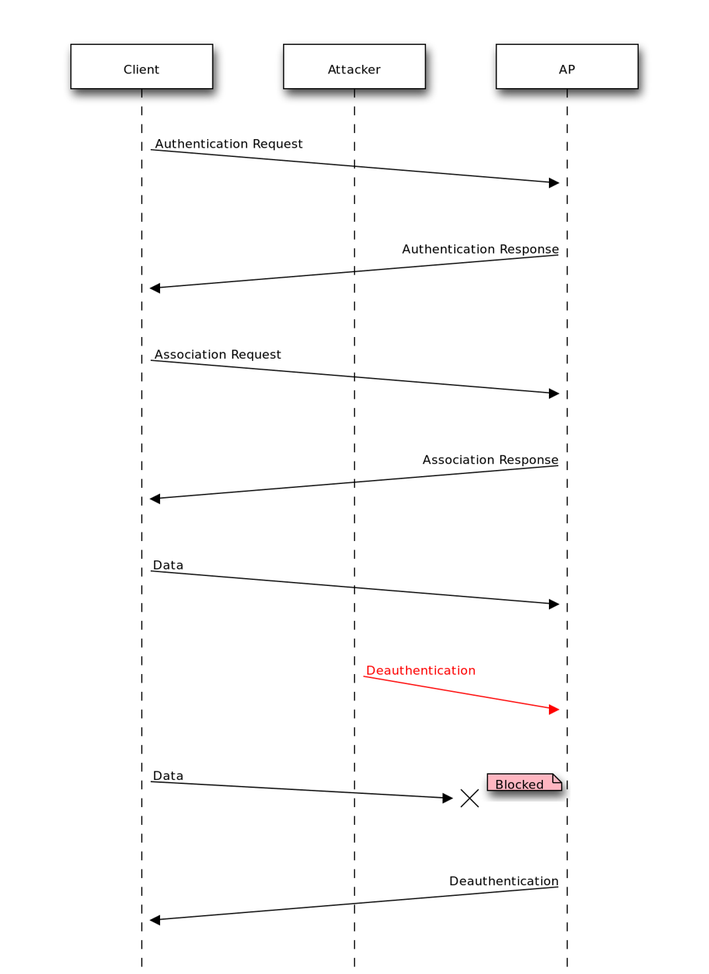
What Is Deauthing?
Abuse of a Wi-Fi protocol to kick people from the Wi-Fi
Wi-Fi De-authentication frame
Exist for the access point to kick a client the network
Forcing a client to switch to a new AP
Occurs if Wi-Fi password is changed

Slide 5
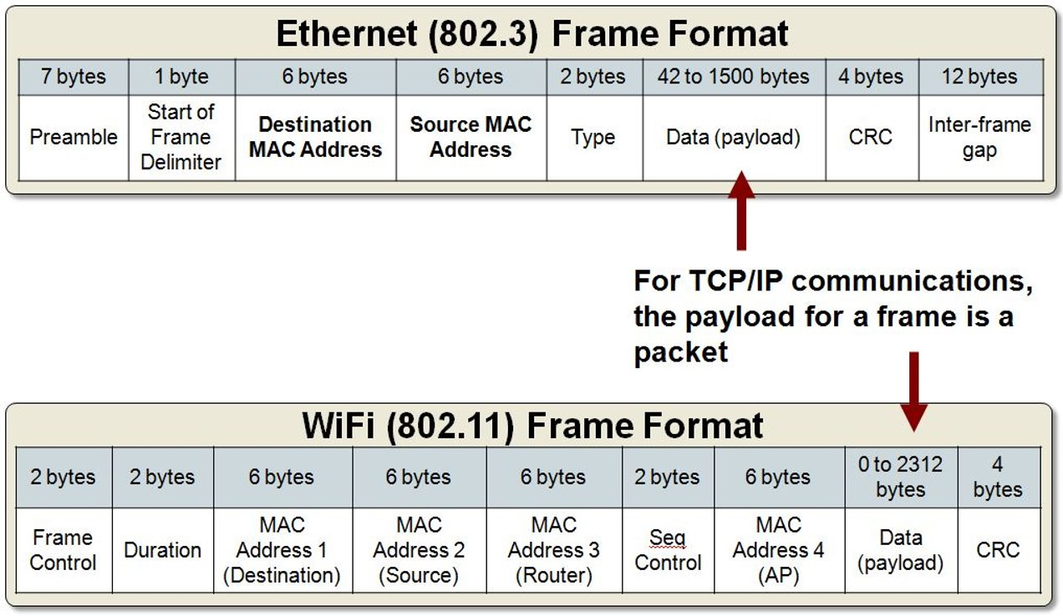
What Are Frames?​
Frames exist at layer 2​
Smallest form of data on the layer 2 level​
Control layer 2 devices​
Encapsulate and transmit data from higher layers

Slide 6
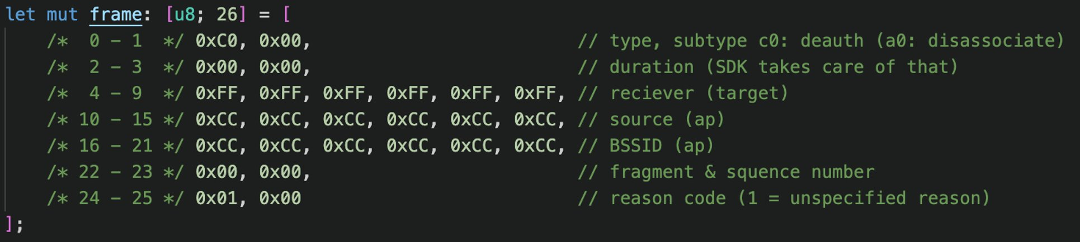
The Deauth Frame

Slide 7
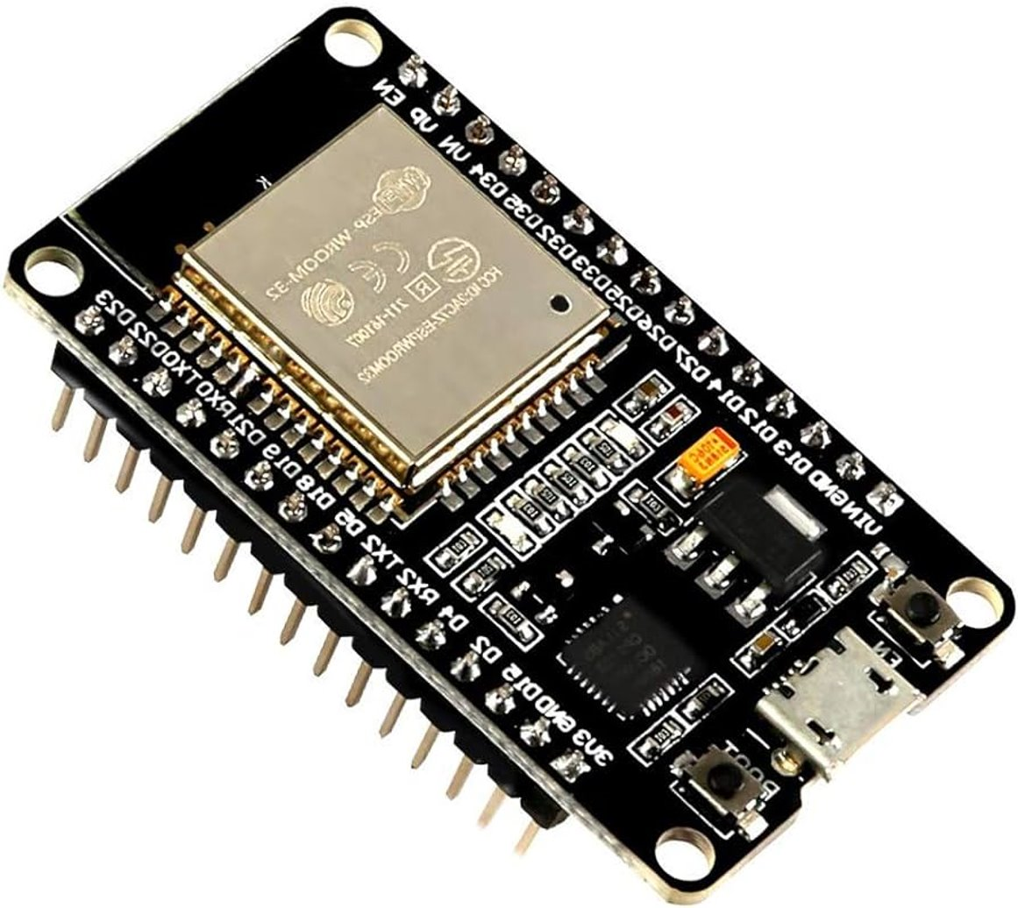
ESP-32
Low powered, cheap Wi-Fi device​
About $15 for 3​
Generally used for IoT applications​
Generally programmed in C​
Has growing Rust support

Slide 8
ESP-32 Challenges
SDK prohibits sending deauth frames​
Does not support 5 GHz Wi-Fi​
Newer revisions do, but I don’t have that

Slide 9
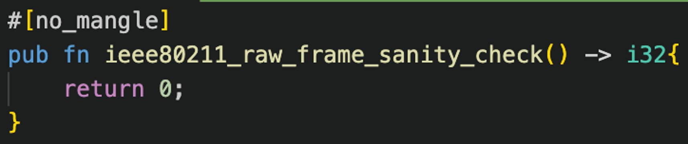
Bypassing Checks
Needed to find the check that stops deauth frames​
Found ieee80211_raw_frame_sanity_check() through Ghidra decomplication​
Normally, this function would return 0 to indicate that the frame is valid​
I need to overwrite this function

Slide 10
Function Name Mangling​
Mangling makes function names random
Beneficial for security
Recompiles with a random name every time
Makes it hard to overwrite
Prevents mistakes
Dependencies may have function names that a developer is not aware of
Needed for SDKs
I need to be able to call the function by name from my code
Function names need to match across programs to overwrite

Slide 11
Demo
Wi-Fi Hotspot
Laptop sniff packets
ESP-32
Send deauth frame
Analyze in Wireshark

Slide 12
Prevent Attack
Use Protected Management Frames (PMF)
Encrypts control frames
Use WPA-3
Mandates the usage of PMF

